Slide 1
Developing a Large Language Model for Coding Negotiation Transcripts
Thanks to NTR for supporting this project
Ray Friedman, Vanderbilt University (Ray.Friedman@Vanderbilt.edu)
Jeanne Brett, Kellogg Graduate School of Management, NTR
And the many transcript contributors, who are model co-authors*
Data Scientists: Jaewoo Cho, Xuhui Zhan, Ningyu Han, Sriram Kannan, Yingxiang Ma, Jesse Spencer-Smith, Manish Acharya
* Wendi Adair, Soroush Aslani, Tayfun Aykac, Chris Bauman, Rebecca Bennett, Garrett Brady, Peggy Briggs, Cheryl Dowie, Chase Eck, Igmar Geiger, Frank Jacob, Molly Kern, Sujin Lee, Leigh Anne Liu, Wu Liu, Jeﬀrey Loewenstein, Anne Lytle, Li Ma, Michel Mann, Alexandra Mislin, Tyree Mitchell, Hannah Martensen ne Nagler, Amit Nandkeolyar, Mara Olekalns, Elena Paliakova, Jennifer Parlamis, Jason Pierce, Nancy Pierce, Robin Pinkley, Nathalie Prime, Jimena Ramirez-Marin, Kevin Rockmann, William Ross, Zhaleh Semnani-Azad, Juliana Schroeder, Philip Smith, Elena Stimmer, Roderick Swaab, Leigh Thompson, Zhaleh Thompson, Cathy Tinsley, Ece Tuncel, Laurie Weingart, Robert Wilken, JingJing Yao, and Zhi-Xue Zhang.

Slide 2
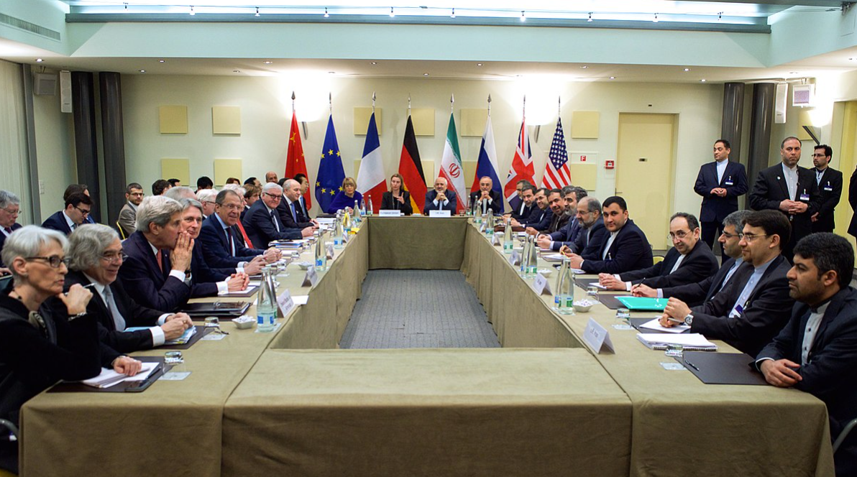
Build Tools for Negotiation Researchers
(NOT creating a negotiation chatbot)

Slide 3
Coding Transcripts

Slide 4
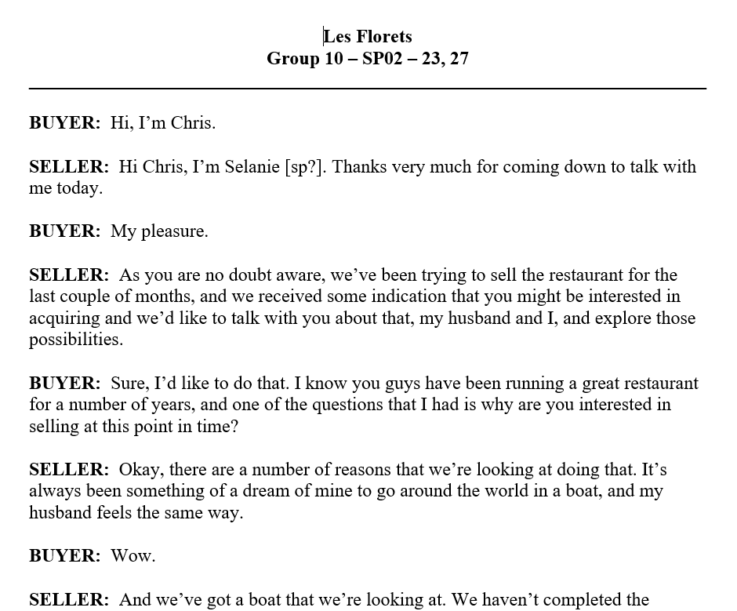
Many Negotiation Studies Code Transcripts
Typical Research Process
Run simulations
Record conversations
Select coding system for research question
Two people code
Check for agreement
Use assigned codes for analysis

Slide 5
Sample Research Questions (Jackel et al.,2022)
Immediate or lagged effects of…
Which statements typically precede…
active listening?
humor?
inconsistent communication?
sharing of interest-related questions?
etc

Slide 6
Example Publications
Adair, W. L., Okumura, T., & Brett, J. M. (2001). Negotiation behavior when cultures collide: The United States and Japan. Journal of Applied Psychology.
Code for information sharing about priorities
Compare US and Japanese info sharing, and results
Putnam, L. L., & Jones, T. S. (1982). Reciprocity in negotiations: An analysis of bargaining interaction. Communication Monographs.
Code for supporting arguments (substantiation)
Labor vs management use different strategies to argue?
Weingart, L. R., Bennett, R. J., & Brett, J. M. (1993). The impact of consideration of issues and motivational orientation on group negotiation process and outcome. Journal of Applied Psychology.
Coded for persuasive behaviors (including threats)
How does cooperative orientation shape persuasive behaviors and outcomes?

Slide 7
Many Negotiation Studies Code Transcripts
Typical Research Process
Run simulations
Record conversations
Select coding system for research question
Two people code
Check for agreement
Use assigned codes for analysis
Can AI make that coding process easier and less costly?

Slide 8
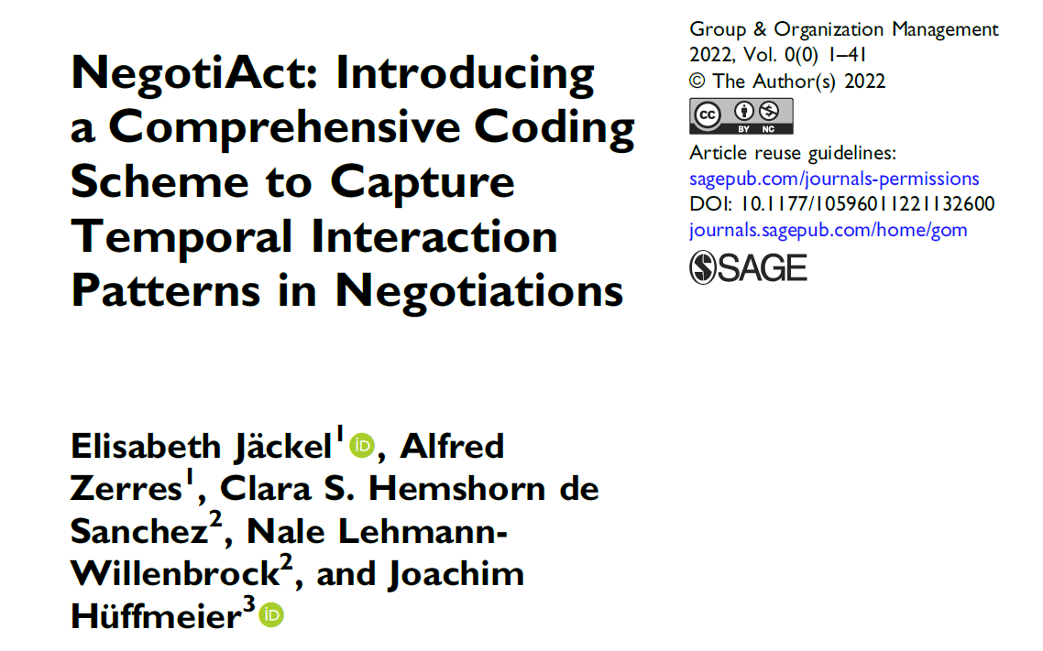
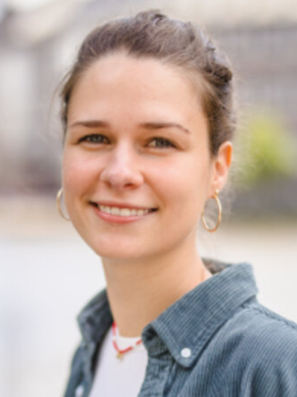
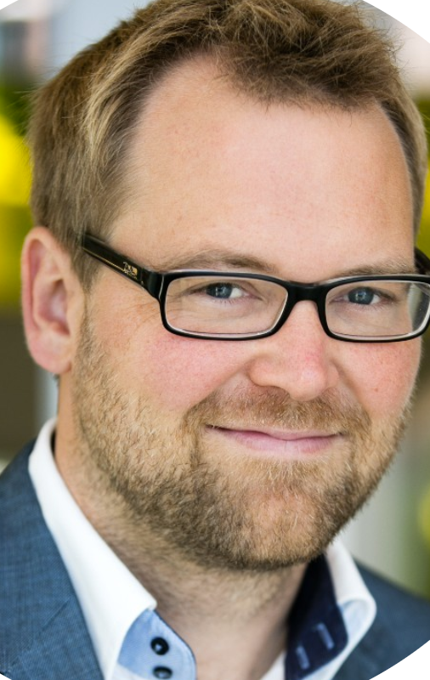
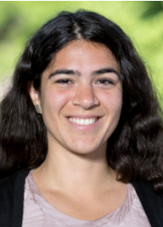
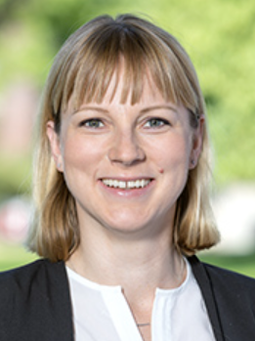
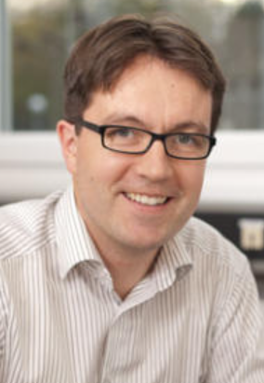

Slide 9
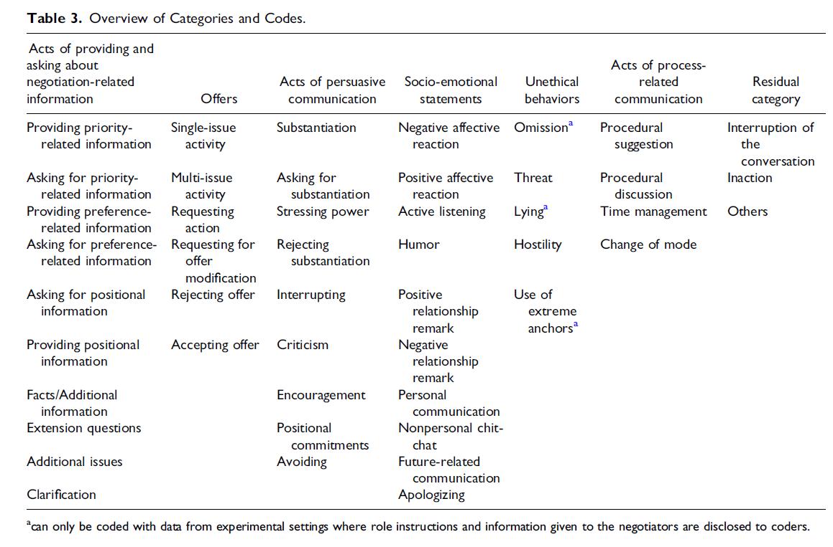
GT
Too many for model to handle

Slide 10
Trimmed to 19
Take out if needs payoff knowledge (e.g. lying)
Keep if from 5 most cited papers
Combine some
Unused codes become: “Other”

Slide 11
Position vs. Interests
Share Information
Priority across issues, e.g. wages v benefits
Preference within issue, e.g. dental benefits v wellness benefits
Offers
Persuade
Socio-Emotional

Slide 12
Is Model Fine Tuning Needed?
Can we code with just the base model (Zero-Shot)?
“Positive Statements”
“Providing Priority-Related Information”

Slide 13
First Strategy – Ideal Sentences
Create 30-90 “Ideal” Sample Sentences per Code
(using simplified version of NegotiAct codes)
Train on 70%
n= ~ 770
Test on 30%
n= ~ 320

Slide 14
Fine Tune a New Model
BASE MODEL
Fine tuned with training data
NEW SEPARATE MODEL
Prompt asks new model to code 320 test sentences

Slide 15
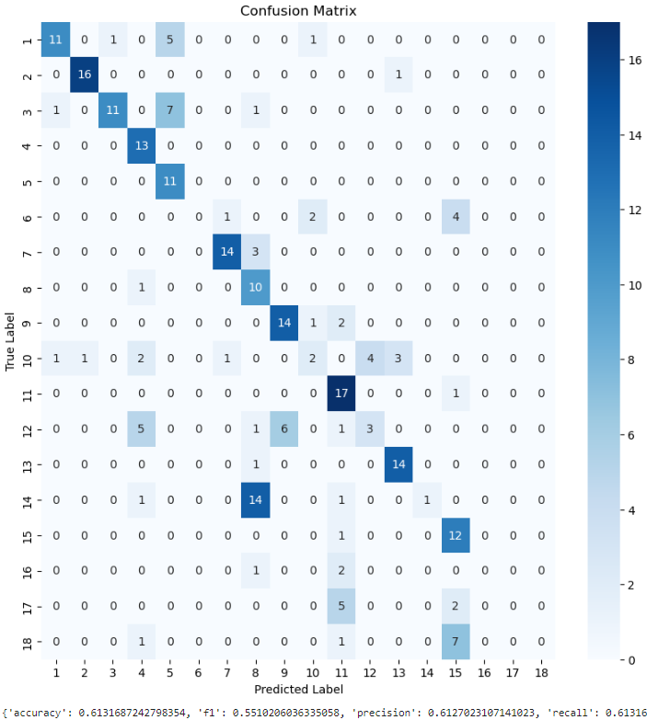
Fine Tuned BERT(from Google) Match of model with expected code:61%
BERT: Bidirectional Encoder Representations from Transformers

Slide 16
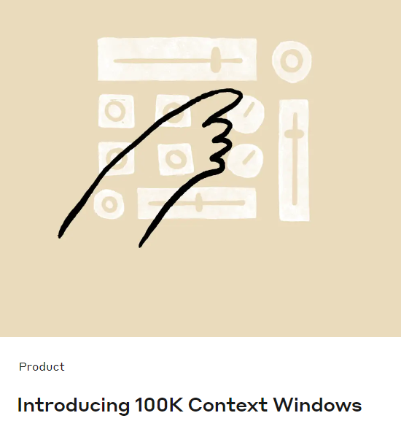
May 2023
Claude 100k Released
Allows 100,000 tokens (vs. 512)
Can include 770 sample sentences in prompt
In-context learning possible
Notes:
https://medium.com/@atmabodha/pre-training-fine-tuning-and-in-context-learning-in-large-language-models-llms-dd483707b122

Slide 17
Fine Tune a New Model
In-Context Learning
BASE MODEL
BASE MODEL
BERT as base model
Model matches “intended” codes 61%
Claude as base model
Fine tuned with training data
Prompt also includes training data
Match matches “intended” codes 94%
NEW SEPARATE MODEL
Prompt asks new model to code 320 test sentences
Prompt asks base model to code 320 test sentences

Slide 18
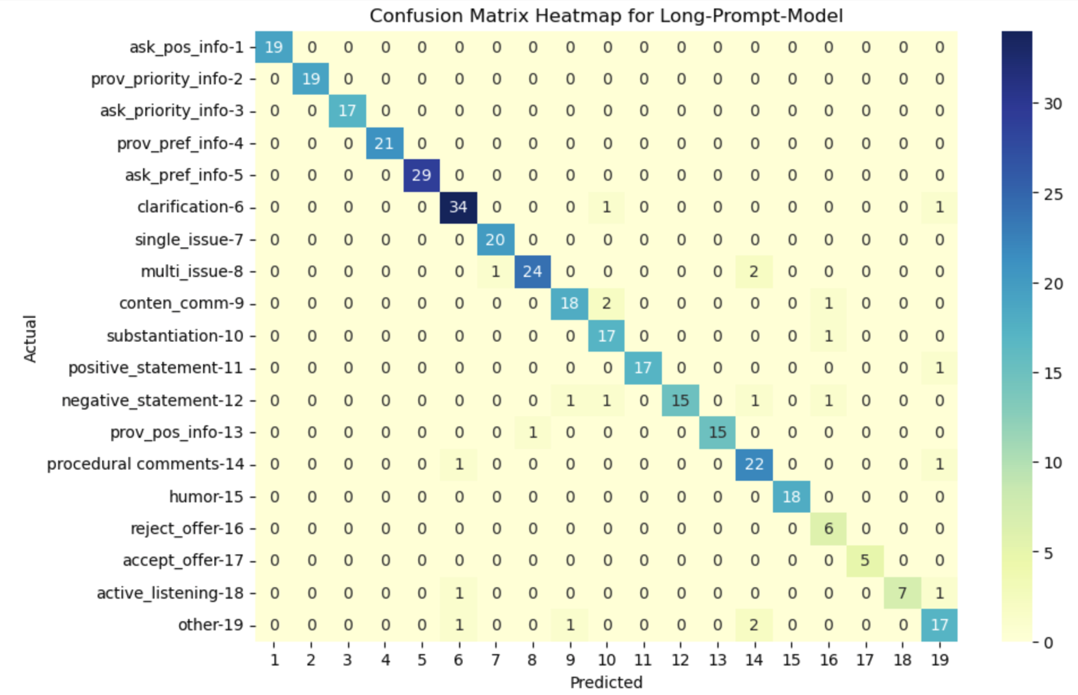
94% Match

Slide 19
Can Code Chinese. Gives Same Code as English

Slide 20
Final Check: Full Transcripts
Real conversations not like sample sentences
32% Match

Slide 21
Revised Strategy – Use Past Coded Transcripts
Coding scheme of scholars who provided transcripts.
Coded transcripts not available for NegotiAct.
Anticipate offering several models.
Train on 5
Test on 20-60 transcripts
Learns the way these coders think.
New plan: Offer many coding schemes.

Slide 22
Challenges
Same codes may be interpreted slightly differently
Human codes include errors
May not be training manuals to guide users
Frequency of codes varies dramatically
Different projects use different units

Slide 23
Units Analyzed
Speaking Turn
Begin/end is clear
Meaning less clear
Sentence
Begin/end is clear, but arbitrary
Meaning more clear
Thought Unit
Meaning most clear
Lots of work to determine
most common
but 70% of
speaking turns are sentences

Slide 24
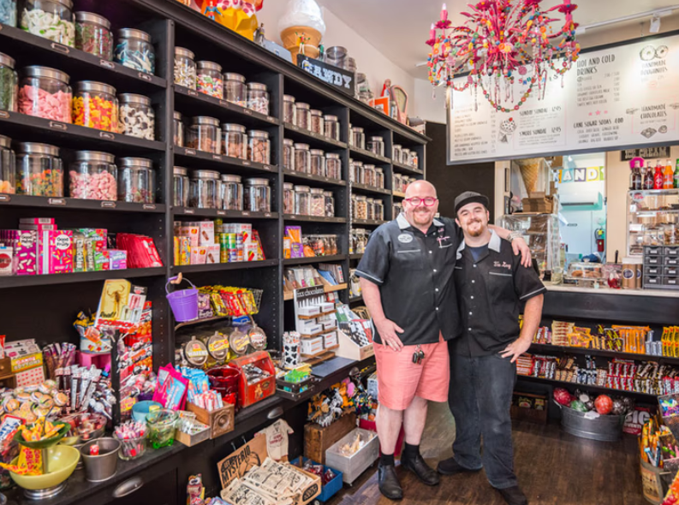
Model 1 – Aslani et al (2016) – Anthropic (Opus)
Offer Single (OS)
Offer Multi-Issue (OM)
Offer Accept (OA)
Offer Reject (OR)
Question (Q)
Provide Information (I)
Substantiation (S)
Positive Reaction (RP)
Negative Reaction (RN)
Summarize (Sum)
Procedural Comment (Proc)
Miscellaneous On-Task (MI)
Miscellaneous Off-Task (OT)
75 Transcripts
- The Sweetshop
- Speaking turn is unit
- 72% have one sentence

Slide 25
Prompt Includes
Five Human-Coded Transcripts
If less than 15 of a code, add made-up examples of that code
More explanation for information v. substantiation
Instructions
“Pay attention to speaker”
“Pay attention to comments before and after”
Format output in certain way
The Transcript to Be Coded

Slide 26
Realize Need to Check Reliability Too
Expect some inconsistency – what is acceptable?
Does model report the same code for that speech unit for five separate runs?
Label: | Perfect Consistency | High Consistency | Modest Consistency | (no code reported) | (no code reported)
Run #1 | Same Code | Same Code | Same Code | Same Code | Same Code
Run #2 | Same Code | Same Code | Same Code | Same Code
Run #3 | Same Code | Same Code | Same Code
Run #4 | Same Code | Same Code
Run #5 | Same Code

Slide 27
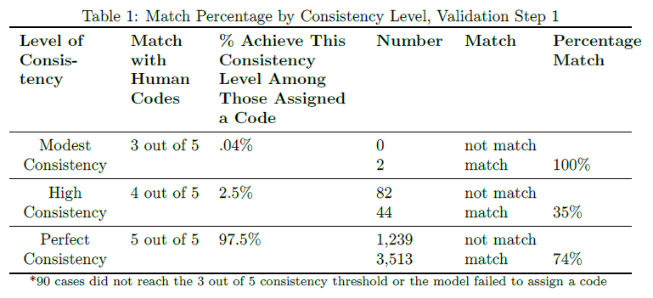
Validation Step 1 - do model’s codes match human-assigned codes for test transcripts?
Overall: 73% match
Overall: 73% match, kappa=.69, 85% estimated observer accuracy
Check: Match levels same for first and second half of transcripts

Slide 28
Human Code | % of units Across All Transcripts | Model Match %
RP | 26.52 | 88.45%
I | 19.41 | 66.96%
Q | 17.42 | 86.46%
OS | 8.07 | 70.41%
S | 8.03 | 59.27%
PROC | 5.53 | 57.76%
OA | 5.16 | 69.38%
MI | 3.81 | 63.78%
SUM | 3.69 | 36.94%
OM | 1.07 | 60.00%
RN | 0.74 | 40.00%
OT | 0.39 | 8.33%
OR | 0.14 | 38.46%
Frequency
RP – 26% of codes
OR – .14% of codes
If more instances of code, get better match
More learning
Offer Single (OS)
Offer Multi-Issue (OM)
Offer Accept (OA)
Offer Reject (OR)
Question (Q)
Provide Information (I)
Substantiation (S)
Positive Reaction (RP)
Negative Reaction (RN)
Summarize (Sum)
Procedural Comment (Proc)
Miscellaneous On-Task (MI)
Miscellaneous Off-Task (OT)

Slide 29
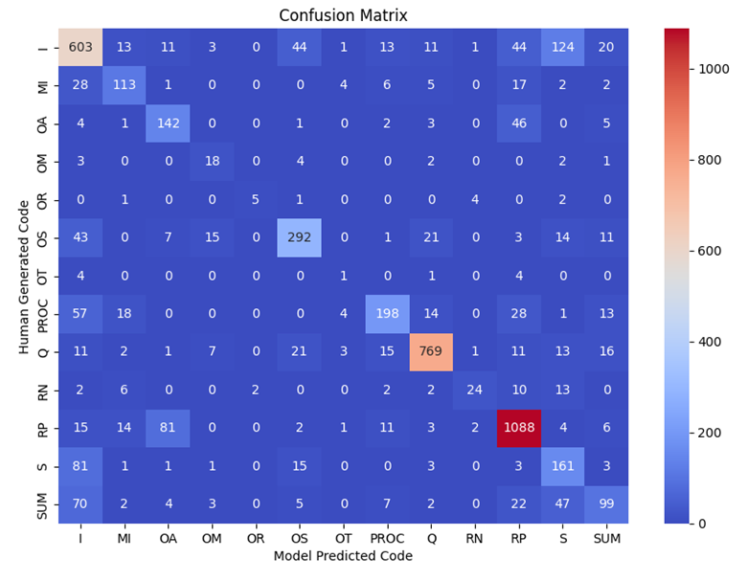
Offer Single (OS)
Offer Multi-Issue (OM)
Offer Accept (OA)
Offer Reject (OR)
Question (Q)
Provide Information (I)
Substantiation (S)
Positive Reaction (RP)
Negative Reaction (RN)
Summarize (Sum)
Procedural Comment (Proc)
Miscellaneous On-Task (MI)
Miscellaneous Off-Task (OT)

Slide 30
Example - Summation? Information?
1: The temperature, yeah.
2: Which one is a good temperature for you?
1: So for temperature, you see, because I’m selling ice cream, I don’t want the temperature to be very cold, right? Because you want to eat ice cream, you don’t want it to be cold, because people normally buy ice cream in the summer, right, because it’s hot.
Providing info on preferences (I) or summarizing where each party stands (Sum)?

Slide 31
Example - Offer Accept? Response Positive?
1: Which is why I think we could maybe, you know, hire individually and train them individually. The only thing I, I would be willing to hire as a group and then provide individual training as we see fit. But I just think that if someone’s working in the ice cream shop, for them to get the sort of training I’ll need them to have to make specialized cakes every day would be a little useless.
2: Okay. I can agree to that.
Is this agreement to a specific offer (OA) or a positive comment on a statement about the situation (RP)?

Slide 32
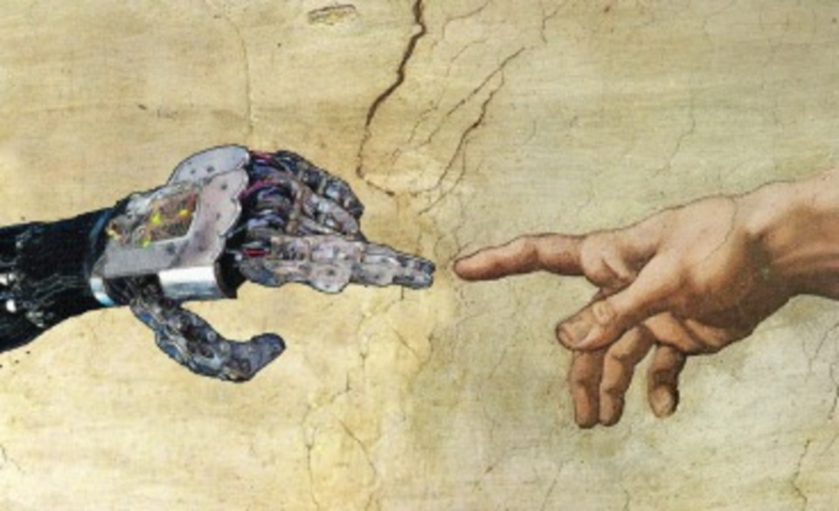
Is Model or Human Right?
Select 100 mismatches at random (from 5/5)
- two new coders
- see model and human codes
- without labels, mixed ordered
“MISMATCH ANALYSIS”
Implication: 91% of model codes valid
Agree with model – 68%
Agree with human – 32%

Slide 33
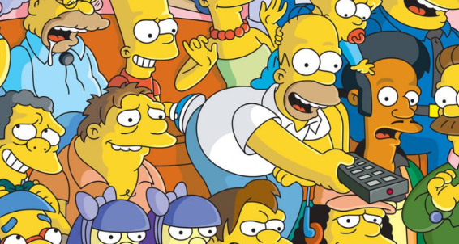
Validation Step 2
Test Sweetshop-trained simulation on other simulations
Human code six “Cartoon” transcripts
also code with model
Human code six “Les Florets” transcripts
also code with model

Slide 34
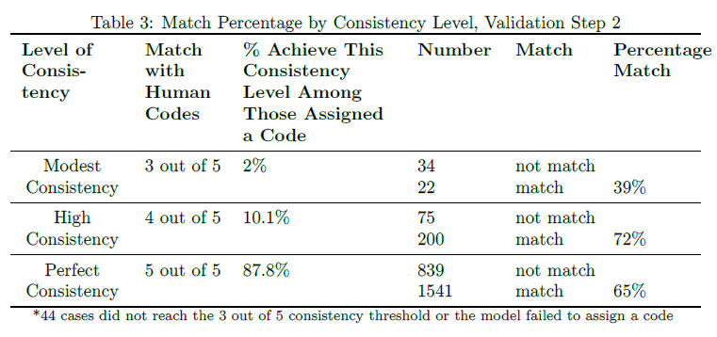
Validation Step 2 - do model’s codes match human-assigned codes for 12 test transcripts?
Overall: 65% match
39%
72%
65%
Overall: 65% match, kappa=.56, 79% estimated observer (model) accuracy
Check: Match levels same for two different simulations

Slide 35
Is Model or Human Right?
Implication: for about half of mismatches, model probably right

Slide 36
Technical Challenges
Corrects grammar, changes meaning
Solved with added prompt, and Claude3
Format of output inconsistent
How it learns varies with each run
Improved with access to API (Application Programing Interface)
Laziness
Solved with arrival of Claude3
Models keep changing… will the ones we tested still be offered?

Slide 37
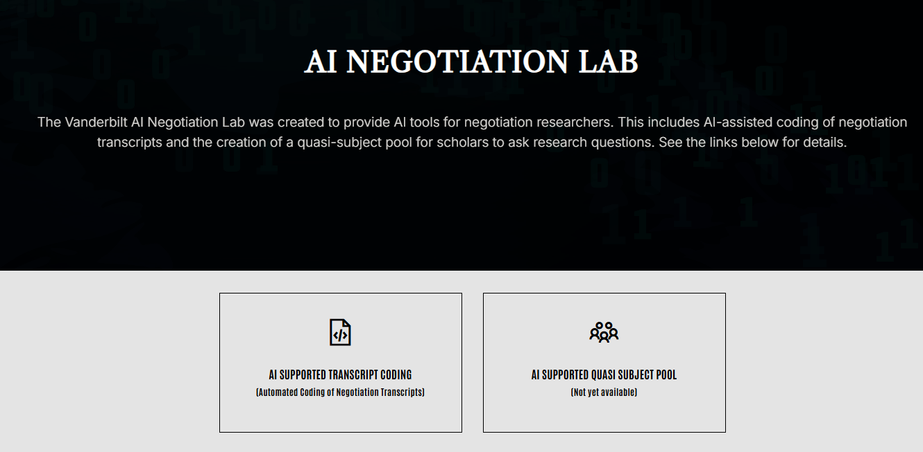
https://www.ainegotiationlab-vanderbilt.com/

Slide 38
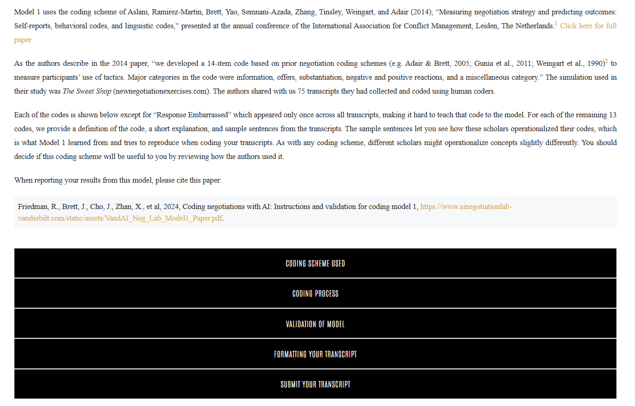
Model 1- Aslani et al 2014
https://www.ainegotiationlab-vanderbilt.com/model_aslani/
Model pages contain
Code definitions and examples
Our validation studies
Instructions for submitting

Slide 39
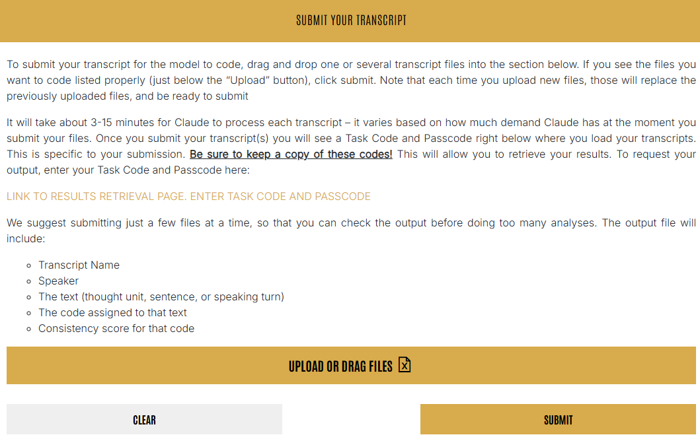

Slide 40
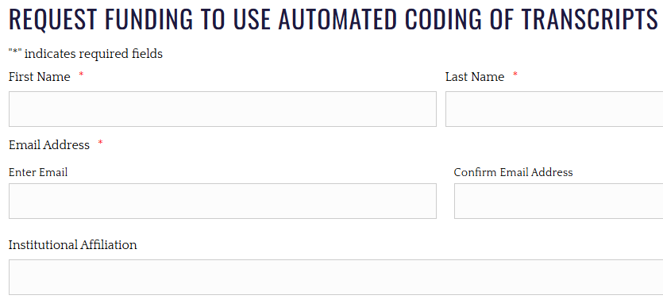
Cost – Whatever we pay Anthropic
Example: Fifty, 80-row transcripts
Model 1: About $410 (uses Opus)
Model 2: About $40 (uses Sonnett)
NTR Grants
https://www.negotiationandteamresources.com/automated-coding-of-negotiation-transcripts/

Slide 41
Questions?

Slide 42
Part II – Quasi Subject Pool
Model absorbs patterns of speech and interaction from 1870 negotiation and dispute transcripts, representing about 4000 people.
As research questions of this “quasi” subject pool – the model.

Slide 43
Quasi Subject Pool Model
Fine Tune a New Model
BASE MODEL
Foundational Model
Large enough
Allows fine tuning
Domain adapted model can be saved
Low cost for users
Solution: GPT 3
Domain Adapt with Transcripts
1817 transcripts
Model: Vanderbilt Quasi Subject Pool v1
Fine tuned with training data
NEW SEPARATE MODEL
Prompt asks new model to code 320 test sentences

Slide 44
1817 Transcripts*
Multi-Country 265
US 1190
India 236
Thailand 45
Korea 33
Russia 20
Hong Kong 17
Australia 5
Germany 5
United Kingdom 1
62% Simulations
3-8 pages (800-2145 words)
96% dyadic
*Source: Wendi Adair, Soroush Aslani, Tayfun Aykac, Chris Bauman, Rebecca Bennett, Garrett Brady, Peggy Briggs, Cheryl Dowie, Chase Eck, Igmar Geiger, Frank Jacob, Molly Kern, Sujin Lee, Leigh Anne Liu, Wu Liu, Jeﬀrey Loewenstein, Anne Lytle, Li Ma, Michel Mann, Alexandra Mislin, Tyree Mitchell, Hannah Martensen ne Nagler, Amit Nandkeolyar, Mara Olekalns, Elena Paliakova, Jennifer Parlamis, Jason Pierce, Nancy Pierce, Robin Pinkley, Nathalie Prime, Jimena Ramirez-Marin, Kevin Rockmann, William Ross, Zhaleh Semnani-Azad, Juliana Schroeder, Philip Smith, Elena Stimmer, Roderick Swaab, Leigh Thompson, Zhaleh Thompson, Cathy Tinsley, Ece Tuncel, Laurie Weingart, Robert Wilken, JingJing Yao, and Zhi-Xue Zhang. (all are co-authors of the model)

Slide 45
Metadata Collected
Integrative/Distributive
Simulation/Natural
Negotiation/Dispute/Mixed
Qualitative/Quantitative Outcome
Dyad/Team/Multiparty
Country of Data Collection
Year Data Collected
If Translated, Original Language?
Experimental Manipulation?

Slide 46
Sample Research Questions (Jackel et al.,2022)
Immediate or lagged effects of…
Which statements typically precede…
active listening?
humor?
inconsistent communication?
sharing of interest-related questions?
etc

Slide 47
Four Possible Research Strategies

Slide 48
Strategy 1
Instruction Given to Model: Person A says: [WE INSERT] Person B says: [MODEL REPLIES]
1. “I need this from you so I can complete my project.”
2. “We need a design that will provide us with stable measurements in the field”
3. “I would like the estimates not to drift over time”
(generate 100 responses)
“Why do you want this from me?”
Research Question: WHAT RESPONSE DOES A STATEMENT TRIGGER?

Slide 49
OUTPUT
CLUSTER USING GENERATIVE AI
ASSESS AND LABEL
1. I need this from you….
2. We need a design that…
3. I would like…
4. I need this from you….
5. We need a design that…
6. I would like…
7. I need this from you….
8. We need a design that…
9. I would like…
10. I need this from you….
11. We need a design that…
12. I would like…
13. I need this from you….
14. We need a design that…
15. I would like…
16. I need this from you….
…
…
100. I would like…
1. I need this from you….
76. We need a design that…
24. I would like…
4. I need this from you….
56. We need a design that…
6. I would like…
77. I need this from you….
98. We need a design that…
12. I would like…
14. I need this from you….
54. We need a design that…
2. I would like…
13. I need this from you….
14. We need a design that…
65. I would like…
76. I need this from you….
…
…
8% of responses are rejections.
65% of responses are requests for more information.
12% of responses are emotional expressions.

Slide 50
Systematically Vary B’s last Comment
A: We'd like to talk about a deal for your restaurant. As you know, we've had an eye on it for years
B: Yes, but there are so many issues we need to figure out. We're not sure you are the right partner for this deal.
A: There are lots of issues. Price. Our alternatives in the market. And what you really want.
B:
Asking Positional Information: You think even for a million francs you could buy a bigger restaurant?
Active Listening: What I hear that you're saying is that you’re probably looking for some support for the business for a few years?
A: Model provides next comment – what it thinks “typical” response would be

Slide 51
Modification: Vary Prior Language
Strategy 2
Cooperative context
Person A says “I’ve been trying to find a way to resolve this and really want to help. Why do you want this from me?” Person B says:
Competitive context
Person A says “You have been opposing everything I think of for the last four hours. Why do you want this from me?” Person B says:
Research Question: HOW DO PRIOR STATEMENTS AFFECT RESPONSE TO A STATEMENT?

Slide 52
Strategy 3
Instruction: Person A says: [Model Replies] Person B says: [Multi-Issue-Offer]
Preceded by:
1.…
2.…
3.…
(generate 100 responses)
Multi-Issue Offer
Research Question: WHAT STATEMENTS MAKE MULTI-ISSUE OFFERS MORE LIKELY?

Slide 53
Train Separate Models
Strategy 4
Distributive Cases v. Integrative Cases
“Vandy Quasi Subject Pool – Distributive”
“Vandy Quasi Subject Pool – Integrative”
Disputes v. Negotiation Cases
Pre-2010 v. post-2010 Cases
Research Questions:
DISTRIBUTIVE VS. INTEGRATIVE NEGOTIATIONS?
ARE PATTERNS DIFFERENT: DISPUTES VS. NEGOTIATIONS?
THE PAST VERSUS MORE RECENT TIMES?

Slide 54
Technical Issues
Setting how “creative” you want model to be
“Temperature”
If 0% creative get nonsense
100% may be too creative
How long an answer do you allow?
Different models have different tendencies

Slide 55
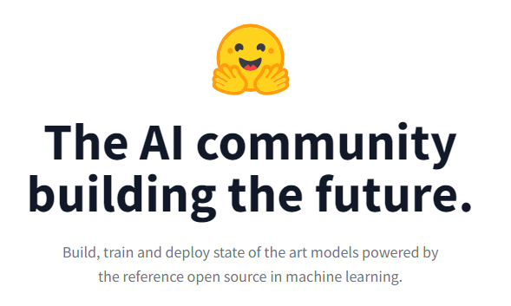
Will Make Public
On Hugging Face
User Notes and Code
Keep Computing Cost Low

